Slide 1

18CSC302J – Computer Networks
Unit IV

Slide 2
Topics
IPV6 Overview, IPV6 Features
IPV6 Addressing Modes
IPV6 Address Types
Address Space Allocation
Global Unicast Addresses
Auto configuration, Renumbering
IPV6 Introduction, IPV6 Routing Protocols
IPV6 Packet Format
Comparison between IPV4 and IPV6 Header
IPV4 to IPV6 Tunneling
IPV4 to IPV6 Translation Techniques
NAT Protocol Translation
IPV6 Mobility
Protocols Changed to Support IPV6
Course Outcome:
At the end of this unit/module, learners will be able to analyse and compare the IPv4 and IPv6 protocols.

Slide 3

IPv6 Overview
IPv4 stood the test of time- a tribute to its initial design
Proven to be robust
Easily implemented
Interoperable
The initial design did not anticipate today's Internet scale and size.
Exhausting IPv4 address space
Large routing tables
Simpler management of IPv4 addresses
Security at IP level
QoS requirements

Slide 4
IPv6 Features
The changes introduced by IPv6 can be grouped into seven categories:
Larger Addresses: The new address size is the most noticeable change. IPv6 quadruples the size of an IPv4 address from 32 bits to 128 bits. The IPv6 address space is so large that it cannot be exhausted in the foreseeable future.
Extended Address Hierarchy:IPv6 uses the larger address space to create additional levels of addressing hierarchy. In particular, IPv6 can define a hierarchy of ISPs as well as a hierarchical structure within a given site.
Flexible Header Format: IPv6 uses an entirely new and incompatible datagram format. Unlike the IPv4 fixed-format header, IPv6 defines a set of optional headers.
Improved Options: Like IPv4, IPv6 allows a datagram to include optional control information. IPv6 includes new options that provide additional facilities not available in IPv4.

Slide 5
IPv6 Features
Provision For Protocol Extension: Perhaps the most significant change in IPv6 is a move away from a protocol that fully specifies all details to a protocol that can permit additional features. The extension capability has the potential to allow the IETF to adapt the protocol to changes in underlying network hardware or to new applications.
Support For Auto configuration And Renumbering: IPv6 provides facilities that allow computers on an isolated network to assign themselves addresses and begin communicating without depending on a router or manual configuration. The protocol also includes a facility that permits a manager to renumber networks dynamically.
Support For Resource Allocation: IPv6 has two facilities that permit pre-allocation of network resources: a flow abstraction and a differentiated service specification. The latter will use the same approach as IPv4's differentiated services.

Slide 6
IPv6 Addressing Modes
128 bits (or 16 bytes) long: four times as long as its predecessor.
2¹²⁸ : about 340 billion billion billion billion different addresses
Colon hexadecimal notation:
addresses are written using 32 hexadecimal digits.
digits are arranged into 8 groups of four to improve the readability.
Groups are separated by colons
2001:0718:1c01:0016:020d:56ff:fe77:52a3
Note:
DNS plays an important role in the IPv6 world
(manual typing of IPv6 addresses is not an easy thing,
Some zero suppression rules are allowed to lighten this task at least a little.

Slide 7
IPv6 Addressing Modes
IPv6 defines three address types:
Unicast Identifies an interface of an individual node.
Multicast Identifies a group of interfaces, usually on different nodes. Packets that are sent to the multicast address go to all members of the multicast group.
Anycast Identifies a group of interfaces, usually on different nodes. Packets that are sent to the anycast address go to the anycast group member node that is physically closest to the sender.

Slide 8
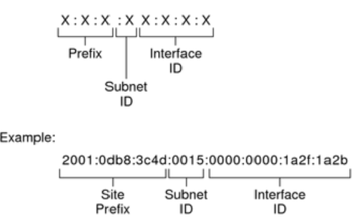
Parts of the IPv6 Address

Slide 9
Parts of the IPv6 Address
The leftmost three fields (48 bits) contain the site prefix. The prefix describes the public topology that is usually allocated to your site by an ISP or Regional Internet Registry (RIR).
The next field is the 16-bit subnet ID, which you (or another administrator) allocate for your site. The subnet ID describes the private topology, also known as the site topology, because it is internal to your site.
The rightmost four fields (64 bits) contain the interface ID, also referred to as a token. The interface ID is either automatically configured from the interface's MAC address or manually configured in EUI-64 format.

Slide 10
Parts of the IPv6 Address
2001:0db8:3c4d:0015:0000:0000:1a2f:1a2b
This example shows all 128 bits of an IPv6 address. The first 48 bits, 2001:0db8:3c4d, contain the site prefix, representing the public topology. The next 16 bits, 0015, contain the subnet ID, representing the private topology for the site. The lower order, rightmost 64 bits, 0000:0000:1a2f:1a2b, contain the interface ID.

Slide 11
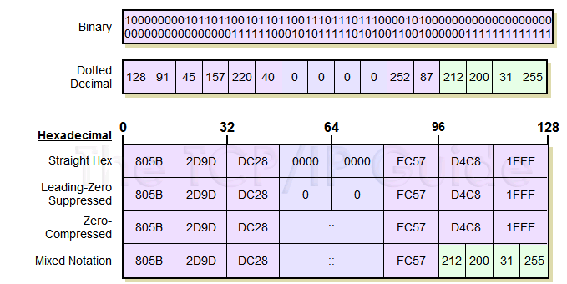
IPv6 Address Notation: Example
128.91.45.157.220.40.0.0.0.0.252.87.212.200.31.255

Slide 12
Rule 1- IPv6 Zero Suppression
Some types of addresses contain long sequences of zeros.
To further simplify the representation of IPv6 addresses, a contiguous sequence of 16-bit blocks set to 0 in the colon hexadecimal format can be compressed to “::”, known as double-colon.
Example:
Original format: 1234:1234:0000:0000:0000:0000:3456:3434
Using zero compression: 1234:1234::3456:3434
Leading zeroes in any 16-bit field can be dropped, but each block you do this with must have at least one number remaining. If the block is all zeroes, you have to leave one zero. This is leading zero compression.

Slide 13
Rule 1- IPv6 Zero Suppression
For example:
link-local address
FE80:0:0:0:2AA:FF:FE9A:4CA2 → FE80::2AA:FF:FE9A:4CA2.
multicast address
FF02:0:0:0:0:0:0:2 → FF02::2
loopback address
0:0:0:0:0:0:0:1 → ::1

Slide 14
Rule 1- IPv6 Zero Suppression
Zero compression can only be used to compress a single contiguous series of 16-bit blocks expressed in colon hexadecimal notation.
You cannot use zero compression to include part of a 16-bit block.
Example:
Original format:
1234:0000:1234:0000:1234:0000:0123:1234
With leading zero compression:
1234:0:1234:0:1234:0:123:1234
Recap..
Zero compression: Allowed only once per address.
Leading zero compression: Perform as often as you like in an address.
For example,
cannot express FF02:30:0:0:0:0:0:5 as FF02:3::5
correct representation = FF02:30::5
Leading zeroes in every group can be omitted.
2001:718:1c01:16:20d:56ff:fe77:52a3

Slide 15
Rule 1- IPv6 Zero Suppression
To determine the number of 0 bits represented by the “::”
count the number of blocks in the compressed address
(-) subtract this number from 8
(*) multiply the result by 16.
For example
FF02::2
two blocks - “FF02” block and “2” block.
The number of bits expressed by the “::” is 96 (96 = (8 – 2)×16).
Zero compression can only be used once in a given address.
Otherwise, you could not determine the number of 0 bits represented by each instance of “::”.

Slide 16
Example 1
Show the unabbreviated colon hex notation for the following IPv6 addresses:
a. An address with 64 0s followed by 64 1s.
b. An address with 128 0s.
c. An address with 128 1s.
d. An address with 128 alternative 1s and 0s.
Solution
a. 0000:0000:0000:0000:FFFF:FFFF:FFFF:FFFF
b. 0000:0000:0000:0000:0000:0000:0000:0000
c. FFFF:FFFF:FFFF:FFFF:FFFF:FFFF:FFFF:FFFF
d. AAAA:AAAA:AAAA:AAAA:AAAA:AAAA:AAAA:AAAA

Slide 17
Example 2
The following shows the zero contraction version of addresses in Example 1 (part c and d cannot be abbreviated)
a. :: FFFF:FFFF:FFFF:FFFF
b. ::
c. FFFF:FFFF:FFFF:FFFF:FFFF:FFFF:FFFF:FFFF
d. AAAA:AAAA:AAAA:AAAA:AAAA:AAAA:AAAA:AAAA

Slide 18
Example 3
Show abbreviations for the following addresses:
a. 0000:0000:FFFF:0000:0000:0000:0000:0000
b. 1234:2346:0000:0000:0000:0000:0000:1111
c. 0000:0001:0000:0000:0000:0000:1200:1000
d. 0000:0000:0000:0000:0000:FFFF:24.123.12.6
Solution
a. 0:0:FFFF::
b. 1234:2346::1111
c. 0:1::1200:1000
d. ::FFFF:24.123.12.6

Slide 19
Example 4
Decompress the following addresses and show the complete unabbreviated IPv6 address:
a. 1111::2222
b. ::
c. 0:1::
d. AAAA:A:AA::1234
Solution
a. 1111:0000:0000:0000:0000:0000:0000:2222
b. 0000:0000:0000:0000:0000:0000:0000:0000
c. 0000:0001:0000:0000:0000:0000:0000:0000
d. AAAA:000A:00AA:0000:0000:0000:0000:1234

Slide 20
IPv6 Prefixes
The prefix is the part of the address that indicates the bits that have fixed values or are the bits of the subnet prefix.
Prefixes for IPv6 subnets, routes, and address ranges are expressed in the same way as Classless Inter-Domain Routing (CIDR) notation for IPv4.
An IPv6 prefix is written in address/prefix-length notation.
For example, 21DA:D3::/48 and 21DA:D3:0:2F3B::/64 are IPv6 address prefixes.
Note IPv4 implementations commonly use a dotted decimal representation of the network prefix known as the subnet mask. A subnet mask is not used for IPv6. Only the prefix length notation is supported.

Slide 21
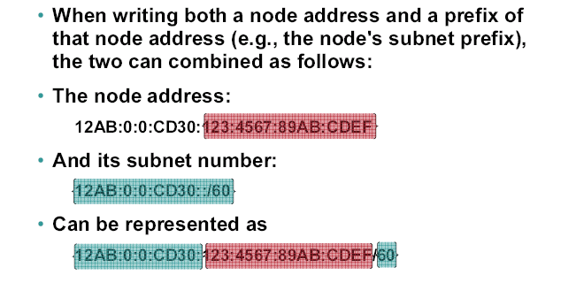
IPv6 Prefixes

Slide 22
IPv6 Address Types
Three major categories of IPv6 addresses:
Unicast—For a single interface.
Multicast—For a set of interfaces on the same physical medium. A packet is sent to all interfaces associated with the address.
Anycast—For a set of interfaces on different physical media. A packet is sent to only one of the interfaces associated with this address, not to all the interfaces.
IPv6 has no broadcast addresses: multicast addresses took over.

Slide 23
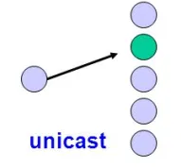
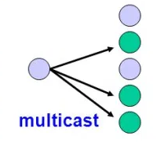
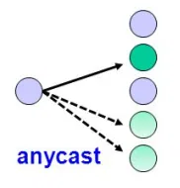
IPv6 Address Types
One – one
One – Many
One – Any

Slide 24
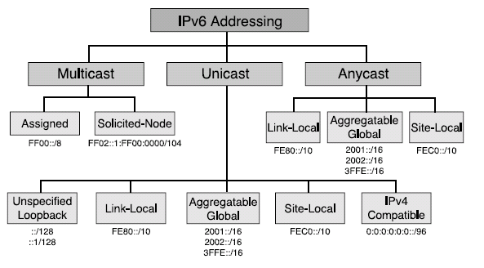
IPv6 Address Types
address resolution to reach the neighboring nodes attached to the same link
groups of devices used by Operating System and same interface
Private addressing within a campus
carry an IPv4 address in the low-order 32 bits of the address
global routing table(ISP)

Slide 25
Unicast Addresses
A unicast address identifies a single interface.
When a network device sends a packet to a unicast address, the packet goes only to the specific interface identified by that address.
Unicast addresses support a global address scope and two types of local address scopes.
A unicast address consists of n bits for the prefix, and 128 – n bits for the interface ID.

Slide 26
Unicast Addresses
In the IPv6 implementation for a subscriber access network, the following types of unicast addresses can be used:
Global unicast address - A unique IPv6 address assigned to a host interface. These addresses have a global scope and essentially the same purposes as IPv4 public addresses. Global unicast addresses are routable on the Internet.
Link-local IPv6 address - An IPv6 address that allows communication between neighboring hosts that reside on the same link. Link-local addresses have a local scope, and cannot be used outside the link. They always have the prefix FE80::/10.
Loopback IPv6 address - An IPv6 address used on a loopback interfaces. The IPv6 loopback address is 0:0:0:0:0:0:0:1, which can be notated as ::1/128.
Unspecified address -An IPv6 unspecified address is 0:0:0:0:0:0:0:0, which can be notated as ::/128.

Slide 27
Multicast Addresses
A multicast address identifies a set of interfaces that typically belong to different nodes.
When a network device sends a packet to a multicast address, the device broadcasts the packet to all interfaces identified by that address.
IPv6 does not support broadcast addresses, but instead uses multicast addresses in this role.
Multicast addresses support 16 different types of address scope, including node, link, site, organization, and global scope.
A 4-bit field in the prefix identifies the address scope.

Slide 28
Multicast Addresses
The following types of multicast addresses can be used in an IPv6 subscriber access network:
Solicited-node multicast address - Neighbor Solicitation (NS) messages are sent to this address.
All-nodes multicast address - Router Advertisement (RA) messages are sent to this address.
All-nodes multicast address - Router Advertisement (RA) messages are sent to this address.
All-routers multicast address - Router Solicitation (RS) messages are sent to this address.
Multicast addresses use the prefix FF00::/8.

Slide 29
Anycast Addresses
An anycast address identifies a set of interfaces that typically belong to different nodes.
Anycast addresses are similar to multicast addresses, except that packets are sent only to one interface, not to all interfaces.
The routing protocol used in the network usually determines which interface is physically closest within the set of anycast addresses and routes the packet along the shortest path to its destination.
There is no difference between anycast addresses and unicast addresses except for the subnet-router address.
For an anycast subnet-router address, the low-order bits, typically 64 or more, are zero.
Anycast addresses are taken from the unicast address space.

Slide 30
IPv6 Notation
Address type | Binary prefix | IPv6 notation
Unspecified | 00 . . . 0 (128 bits) | ::/128
Loopback | 00 . . . 1 (128 bits) | ::1/128
Multicast | 11111111 | FF00::/8
Link-local unicast | 1111111010 | FE80::/10
Site-local unicast | 1111111011 | FEC0::/10
Global unicast | (everything else)

Slide 31
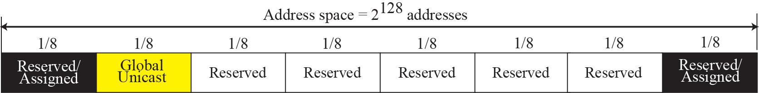
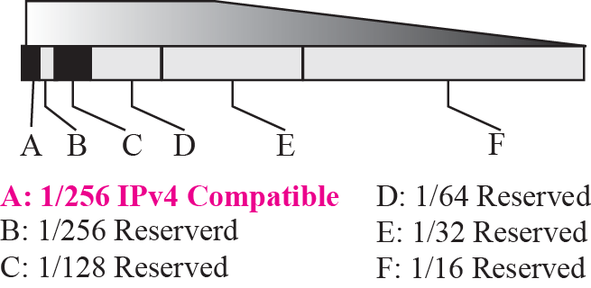
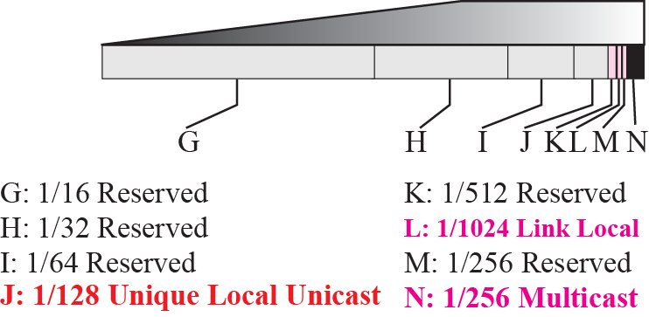
Address space allocation
The first section contains six variable-size blocks
Five sections are unassigned addresses
Some are reserved for special purposes
More than five-eighths of the address space is still unassigned

Slide 32
Address space allocation

Slide 33
Example
Figure Address space allocation shows that only a portion of the address space can be used for global unicast communication. How many addresses are in this block?
Solution
This block occupies only one-eighth of the address spaces. To find the number of addresses, we can divide the total address space by 8 or 2³ . The result is (2¹²⁸)/(2³) = 2¹²⁵ —a huge block.

Slide 34
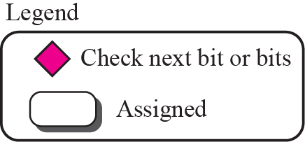

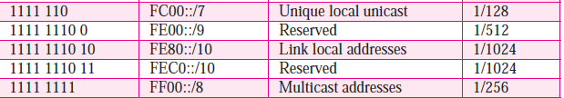
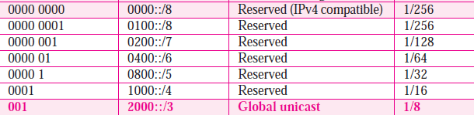
Algorithm for finding the allocated blocks

Slide 35
Global Unicast Addresses
Primary used to address the System for one-one Communication mechanism i.e host to host direct communication over the internet.
Global unicast address is equivalent to public IPV4 address
Global unicast address objective is to reach any host globally across the internet uniquely
Address block refer this is called global unicast address block
CIDR Notation for the block is 2000::/3, where 3 refers to that 3 leftmost bit is common for all address in this block (001)
The size of the address space is 2¹²⁵ which is more than for expansion of internet in many years

Slide 36
Global Unicast Addresses
Three Levels of Hierarchy
n bits
128-n-m bits
m bits
Global routing prefix
Subnet Identifier
Interface Identifier
Global Unicast Address
Block Assignment | Length of block
Global routing prefix (n) | 48 bits
Subnet Identifier (128-n-m) | 16 bits
Interface Identifier | 64 bits
Recommended length for each block in Global unicast address

Slide 37
Three levels of Hierarchy
Global Routing Preﬁx :
The first 48 bits of a global unicast address are called global routing prefix.
They are used to route the packet through the Internet to the organization site such as ISP that owns the block.
The first three bits in this part is fixed (001), Remaining 45 bits can defined up to 245 sites
The global routers in the Internet route a packet to its destination site based on the value of n.

Slide 38
Three levels of Hierarchy
Subnet Identifier :
16 bit block is used to identify the specific subnet of an organization.
An organization can have upto 2¹⁶ subnets.
Interface Identifier :
Last 64 bits refers to the interface identifier. It is similar to the hostId in IPV4 scheme.
In IPV4 addressing, there is no relation between the hostid (32 bits) and MAC(48 bits) due to the difference in length.
Physical address whose length is less than 64 bits can be embedded as the whole or part of the interface identifier, eliminating the mapping process with the help of IPv6.
Two common physical addressing scheme can be considered for this purpose: the 64-bit extended unique identiﬁer (EUI-64) deﬁned by IEEE and the 48-bit physical address deﬁned by Ethernet.

Slide 39

Mapping EUI-64
To map a 64-bit physical address, the global/local bit of this format needs to be changed from 0 to 1 (local to global) to define an interface address

Slide 40

Mapping Ethernet MAC Address
To map 48-bit Ethernet address into a 64-bit interface identifier, we need to change the local/global bit to 1 and insert an additional 16 bits. The additional 16 bits are defined as 15 ones followed by one zero, or FFFE16.

Slide 41
Example of mapping address from one format to other
Find the interface identiﬁer if the physical address in the EUI is (F5-A9-23-EF-07-14-7A-D2) 16 using the format we deﬁned for Ethernet addresses.
Soln : To map the EUI to interface identifier we need to invert the seventh bit of first octet. The first octet value
F5 -> (11110101)
F7 -> (11110111)
Interface identifier is F7-A9-23-EF-07-14-7A-D2

Slide 42
Example of mapping address from one format to other
2. Find the interface identiﬁer if the Ethernet physical address is (F5-A9-23-14-7A-D2)16 using the format we deﬁned for Ethernet addresses.
Soln : To map the Ethernet address to interface identifier, we need to invert the seventh bit of first octet and FFFE has to be inserted after the 3 octet.
F5-A9-23-14-7A-D2 (11110101)
F7-A9-23-FF-FE-14-7A-D2 (11110111)

Slide 43
IPV6 Auto configuration
Auto configuration helps the nodes in an IPv6 network to automatically get configured without any human intervention.
Type of Auto-Configuration
a) Stateful Auto-configuration.
It requires a certain level of human intervention because it needs a Dynamic Host Configuration Protocol for IPv6 (DHCPv6) server for the installation and administration of the nodes.
The DHCPv6 server keeps a list of nodes to which it supplies configuration information.
It also maintains state information so the server knows how long each address is in use, and when it might be available for reassignment.

Slide 44
IPV6 Auto configuration
b) Stateless Auto-configuration.
This is suitable for small organizations and individuals.
Each host determines its addresses from the contents of received router advertisements.
Using the IEEE EUI-64 standard to define the network ID portion of the address, it is reasonable to assume the uniqueness of the host address on the link.

Slide 45
Dynamic Addressing
Dynamic addressing starts with IPv6 Router Advertisement (RA) Messages. It informs the network devices about how they can reach IPv6 addressing Information.
Router Advertisement (RA) Messages are sent periodically or any time after receiving a Solicitation Message. Routers answers in four ways for this RA messages:
SLAAC (Stateless) - Use only router advertisements
SLAAC + DHCPv6 (Stateless) - Use router advertisements and DHCPv Server
DHCPv6 (Statefull) - Use DHCP server Only
DHCPv6 (Statefull + Stateless) - Use DHCP server Only but we can use stateless also

Slide 46
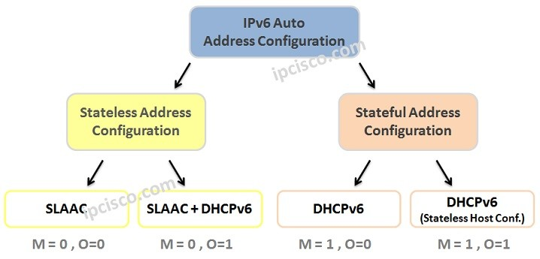
Dynamic Addressing
There are three important flags in a Router Advertisement Message, to use DHCPv6 or not. These flags are:
Other Configuration Flag (O Flag)
Managed Configuration Flag (M Flag)
Auto Configuration Flag (A Flag)
“O” flag indicates that, Stateless Auto Configuration will be done or not.
“M” flag indicates that Auto IP Configuration will be done with DHCP version 6 or Not.
If A flag is 1, Auto stateless configuration is done. if 0 then statefull DHCP is used.

Slide 47
Auto Configuration
Auto configuration enables the host to assign the IPV6 address on its own.
In IPV4 usually the network manager will assign the address (static) for each host in the network in-case if the network uses DHCP (dynamic host configuration protocol) the host will be assign a dynamic address when the host join the network and it keeps changing every time it joins the network.
Auto Configuration process:
Host create a link local address by taking 10 bit local prefix (1111 1110 10) and add 54 zeros and adding 64 bits interface identifier of its own from the interface card which makes as 128 bit link local address.

Slide 48
Auto Configuration
The host verifies the uniqueness of the link local address by sending the neighbour solicitation message and waits for the neighbour advertisement message. Incase if any of the host address matches then auto configuration process results in failure which can be counter by either DHCP or manual configuration
If the uniqueness test for link local address is successful, then the host send router solicitation message to the local router. If the local router running in the network sends a router advertisement message from which thee host extract the global unicast prefix and the subnet prefix and append the same with local link to complete the address. Incase if the router cant help for auto configuration it inform the host by setting the flag in the advertisement message.

Slide 49
Computing the global unicast address
Assume a host with Ethernet address (F5-A9-23-11-9B-E2)16 has joined the network. What would be its global unicast address if the global unicast preﬁx of the organization is 3A21:1216:2165 and the subnet identiﬁer is A245:1232.
Soln:
Step 1 : Creating a local link address by adding 10 bit prefix (1111 1110 10) and 54 zeros and append its 64 bit interface ID extracted from the Ethernet address :
FE80 : :F7A9-23FF-FE11-9BE2 (by inverting the seventh bit of 1st octet and adding FFFE after the third octet)
Step 2 : On assuming this uniqueness it send the router solicitation message upon receiving the advertisement message it complete the auto configuration process by extracting the global unicast prefix and subnet identifier from the message as follows 3A21:1216:2165:A245:1232 and append it to the local link address
3A21:1216:2165:A245:1232: F7A9-23FF-FE11-9BE2

Slide 50
Renumbering
Renumbering allow the site to change the service provider and reconfigure the IPV6 address.
If the site changes the service provider the address prefix needs to be changed.
Once the service provider changes the router advertises the new prefix and the site uses the old prefix before its disabling.
The main hindrance in renumbering is support of the DNS, which needs to propagate the new addressing associated with a domain name. Anew protocol called Next generation DNS in exploration.

Slide 51
IPV6 Routing Protocols - Introduction
IPV6 Routing Protocols
IPV6 Packet Format
Comparison between IPV4 and IPV6 Header

Slide 52
Introduction
Introduction
The evolution of IPV6 was due to two major factors:
Address depletion
slowness of the process due to some unnecessary processing, and support for multimedia and security.
IPV6 responds to the above issue by the following modifications
Larger address space. Instead of 32bit addressing scheme it uses 128 bit addressing format.
Better header format. Options are flexible i.e., removed from base header and inserted when needed which speed up the routing process.
New options. IPv6 has new options to allow for additional functionalities.
Allowance for extension. IPv6 is designed to allow the extension of the protocol if required by new technologies or applications.
Support for resource allocation. In place of type-of-service ﬁeld two new ﬁelds, trafﬁc class and ﬂow label have been added to enable the source to request special handling of the packet which enable the support for multimedia transmission
Support for more security. The encryption and authentication options in IPv6 provide conﬁdentiality and integrity of the packet.

Slide 53
IPV6 Routing Protocols
Same Protocols as in IPv4
Static
RIPng (Routing Information Protocol Next Generation)
OSPFv3 ( Open Shortest Path First version 3 )
MP-BGP4 (Modified Protocol Border Gateway Protocol)
Use ping6 and traceroute6 commands to check reachability and route

Slide 54
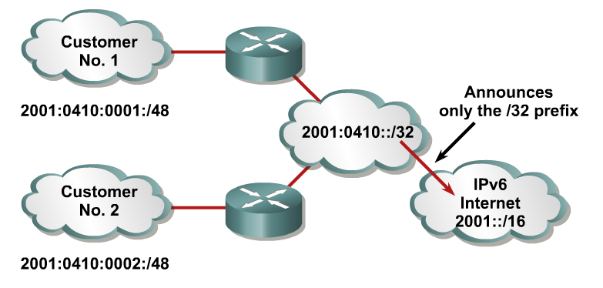
IPV6 Routing Protocols
Aggregation of prefixes announced in the global routing table
Efficient and scalable routing

Slide 55
IPV6 Routing Protocols
Neighbor Discovery Protocol
IPv6 nodes which share the same physical medium (link) use Neighbor Discovery Protocol (NDP) to:
Discover their mutual presence
Determine link-layer addresses of their neighbors (equivalent to ARP)
Find routers
Maintain neighbors’ reachability information
Uses Multicast Address

Slide 56
IPV6 Routing Protocols
Neighbor Discovery Protocol features
Router discovery
Prefix(es) discovery
Parameters discovery (link MTU, Max Hop Limit, ...)
Address auto-configuration
Address resolution
Next Hop determination
Neighbor Unreachability Detection
Duplicate Address Detection
Redirect

Slide 57
IPV6 Routing Protocols
Neighbor Discovery Protocol provides the functionality of
ARP
ICMP redirect

Slide 58
IPV6 Routing Protocols
ND specifies 5 types of ICMP packets:
Router Advertisement (RA) :
Periodic advertisement (of the availability of a router) which contains:
list of prefixes used on the link (autoconf)
a possible value for Max Hop Limit (TTL of IPv4)
value of MTU
Router Solicitation (RS) :
The host needs RA immediately (at boot time)

Slide 59
IPV6 Routing Protocols
Neighbor Solicitation (NS):
to determine the link-layer address of a neighbor
to check its reachability
used to detect duplicate addresses (DAD)
Neighbor Advertisement (NA):
answer to a NS packet
to advertise the change of physical address
Redirect:
Used by a router to inform a host of a better route to a given destination

Slide 60
IPV6 Packet format
40 bytes
Upto 65 535 bytes
Base Header
Payload
Extension Headers (Optional)
Data Packet from upper layers
32 bits = 4 bytes
Version : To specify whether IPV4 or IPV6
Trafﬁc Class : Distinguish the payload.
Flow label : Mention special handling for a particular ﬂow of data.
Payload length : Defines the length of the IP datagram in payload.
Next Header : Optional extension headers used by IP or the header of an encapsulated packet such as UDP or TCP.
Hop Limit : TTL
Source Address: Original source address
Destination Address: Final destination of datagram
0
4
12
16
24
31
VER
Traffic Class
Flow Label
Payload length
Next Header
Hop limit
Source Address
(128 bits = 16 bytes)
Destination Address
(128 bits = 16 bytes)
Format of Base Header

Slide 61
Next Header codes
Code Next Header
0 Hop-by-Hop option
2 ICMP
6 TCP
17 UDP
43 Source routing
44 Fragmentation
50 Encrypted Security Payload
51 Authentication
59 NULL (no next header)
60 Destination Option

Slide 62
Flow Label
IP protocol designed to serve as connectionless protocol, but it has the ability to serve as connection oriented protocol.
Router consider the flow as a sequence of packet share the same characteristics such as path, resources, and security.
Router support the handling of flow label table which has entry for each active flow. When a router receives a packet it check the flow label table for the entry and provides the service mentioned. The information is provided by other means such as the hop-by-hop options or other protocols.
Flow label objective is to speed up the processing of packet i.e. while receiving a packet instead checking the routing table it consults the flow label table to find the next hop.
A ﬂow label used to support the transmission of real-time audio and video. Real-time audio or video, particularly in digital form

Slide 63
Flow Label
Rules for flow label:
Flow label is defined by source host which takes a random number form 1 to 2²⁴ -1 and it must be unique one.
If host doesn’t support the feature its set to zero and if router doesn’t support it simply ignore the field.
All the packets belong to the same flow has same source, same destination, same priority and same option

Slide 64
Extension Header
VER
Traffic Class
Flow Label
Payload length
Next Header
Hop limit
Source Address(128 bits = 16 bytes)
Base Header
Destination Address (128 bits = 16 bytes)
Next Header
Header length
Next Header
Header length
.
.
.
Extension Header
Next Header
Header length
Format of Base Header

Slide 65
Extension Header
Extension Header
Hop-by-Hop
Destination
Source Routing
Fragmentation
Authentication
ESP
Hop-by-Hop is used when source needs to send information to all routers along the path. Used to specify information such as management, debugging and control function also used too specify when datagram size exceeds 65535 bits.
The first field defines the header and next fields defines the length and rest of the field makes options. Only 3 options have been defined are Pad1, PadN, and jumbo Payload.
Options
Next Header
Header length

Slide 66
Options in Hop-by-Hop header
8 bits
8 bits
code
Length
Data (variable length)
Action (2 bits)
C (1 bit)
Type (5 bits)
C Change in option Value
0 Doesn’t change in transit
1 maybe changed in transit
Action (if option not required)
00 Skip this option
01 Discard datagram, no more action
10 Discard datagram and send ICMP message
11 Discard datagram and send ICMP message if not Multicast
Type
00000 Pad1
00001 PadN
00010 Jumbo Payload
Type
Pad1 – used for alignment purpose. Options need to start at specific bit of 32 bit word, if it fall short by 1 bit Pad1 is used. Pad1 excludes the length of option and data field. Pad1 can be inserted anywhere in hop-by-hop
Options
Code
00000
pad1
Rest of the payload
a. Pad1
b. Used for padding

Slide 67
Options in Hop-by-Hop header
code
length
Data
00000001
C (1 bit)
All 0’s
Pad N
1 byte
1 byte
variable
Type
PadN – PadN is used when 2 or more bytes are needed for alignment. PadN is made of 1 byte of option code, 1 byte of the option length, and a variable number of zero padding bytes. The value of the option code is 1 (action is 00, the change bit is 0, and type is 00001). The option length contains the number of padding bytes
Code
11000010
Code
00000100
Jumbo Payload
Length of Jumbo payload ( 4 bytes)
Type
Jumbo payload. Payload in the IP datagram can be a maximum of 65,535 bytes in length, if for any reason payload length is larger than prefer jumbo payload option to deﬁne this longer length. The jumbo payload option must always start at a multiple of 4 bytes plus 2 from the beginning of the extension headers. The jumbo payload option starts at the (4n + 2) byte, where n is a small integer.

Slide 68
Extension Headers
Destination: Destination is used when the source needs to send information only to the destination and prevents the information get accessed by the router along the path. The format of the destination field is same as hop-by-hop option.
Source Routing: Combines the concept of strict and loose routing and minimum of 7 fields length.
Next Header
Header Length
Code
Address left
Next Header and Header length are same as in Hop-by-Hop
Type field defines strict or loose routing.
Address left represents the host need to reach the destination.
strict/loose mask ﬁeld determines the rigidity of routing.
If set to strict, routing must follow the source specification
If set to loose, it may visit other routers
Reserved
Strict/loose mask
First Address
Second Address
:
:
Last address
Note : Destination address in source routing does not refer to the ﬁnal destination of the datagram instead, it changes from router to router. The addresses in the extension headers also change from router to router.

Slide 69
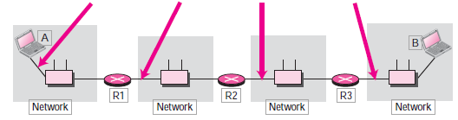
Source Routing Example
If source A wants to send a packet to destination B then, the routing info
Source : A
Destination : R1
Left : 3
R2
R3
B
Source : A
Destination : R2
Left : 2
R1
R3
B
Source : A
Destination : R3
Left : 1
R1
R2
B
Source : A
Destination : R3
Left : 0
R1
R2
R3

Slide 70
Extension Header – Fragmentation & Authentication
Fragmentation
Refers to the process of breaking the segment into smaller fragment
IPV4 either the source (host) or the router performs the fragmentation process based on the MTU (Maximum Transmission Unit)
In IPV6 only the source performs the fragmentation by using Path MTU discovery technique in-order to find the smallest MTU on the path. If the source doesn’t use MTU discovery, it fragment the packet into size of 1280 bytes or smaller
Authentication:
Validates the sender and ensure integrity of data. Validation of sender to insure the message comes for genuine source not from intruder. The integrity is verify the original transmitted message reaches the receiver end.
Security parameter index defines the algorithm used for authentication and the data field contain the actual data generated by the algorithm.
Next Header
Header Length
Fragment offset
0
M
Fragmentation
Fragment Identification
Security parameter index
Authentication Data
Authentication

Slide 71
Authentication of data
128-bit security key
IP datagram with changeable and authentication fields set to zero
Authentication Algorithm
128 bit Authentication data
128-bit security key
Authentication Process
The sender passes a 128-bit security key, the entire IP datagram, and the 128-bit security key again to the algorithm.
Those ﬁelds in the datagram with values that change during transmission (for example, hop count) are set to zero.
The datagram passed to the algorithm includes the authentication header extension, with the authentication data ﬁeld set to zero.
The algorithm creates authentication data which is inserted into the extension header prior to datagram transmission.
The receiver on receiving the message passes the datagram and the secret to the algorithm and compare the result, if it matches the datagram is accepted else discarded.

Slide 72
Extension Header – ESP
Encrypted Security Payload (ESP)
To provide confidentiality and prevent eavesdropping.
The security parameter index defines the type of encryption algorithm used and data field carries the encrypted data and other information if any needed for the algorithm
Encryption can be done either by transport model or tunnel model
Security parameter index
Encrypted Data
ESP

Slide 73
Comparison between IPV4 and IPV6 Header
IPV4 | IPV6
Header length Field | Header length field is eliminated
Service type field | Traffic class and flow label
Total length field | Payload length field
Identification , flag, offset | Fragmentation extension header
TTL | Hop-limit
Protocol | Next Header
Header Checksum | No Checksum
Option fields | Extension Headers

Slide 74
Transition from IPV4 to IPV6
Three strategies used are:
Dual stack
Tunnelling
Header translation
Dual Stack: Before complete migration all station must run in dual mode i.e. Both IPV4 and IPV6
Before sending a packet to the destination the source queries the DNS, if it returns IPV4 then source sends IPV4 packet else send IPV6 packet.
Transport and Application layers
IPV4
IPV6
Underlying LAN or WAN Technology
To IPV4
To IPV6

Slide 75


Transition from IPV4 to IPV6 : Tunnelling
Tunnelling : Process happens when two IPV6 host wants to communicate through a IPV4 Channel, to pass through this channel it requires a IPV4 address. So IPV6 packet is encapsulated in a IPV4 packet and enter the region.
IPv4 packet is carrying an IPv6 packet as data, the protocol value is set to 41
Tunnelling
IPV6 Host
IPV4 Header
IPV6 Host
IPV6 Header
Payload
IPV6 Header
IPV6 Header
Payload
Payload
IPV4 Region

Slide 76
Transition from IPV4 to IPV6 : Header translation
Header Translation acquires when sender uses a IPV6 and receiver uses IPV4, where the IPV6 address needs to be translated to IPV4.
Header translation uses the mapped address to translate an IPv6 address to an IPv4 address. Rules for Translation:
The IPv6 mapped address is changed to an IPv4 address by extracting the right-most 32 bits.
The value of the IPv6 priority ﬁeld is discarded. The type of service ﬁeld in IPv4 is set to zero.
The checksum for IPv4 is calculated and inserted in the corresponding ﬁeld. The IPv6 ﬂow label is ignored.
Compatible extension headers are converted to options and inserted in the IPv4 header. Some may have to be dropped.
The length of IPv4 header is calculated and inserted into the corresponding ﬁeld.
The total length of the IPv4 packet is calculated and inserted in the corresponding ﬁeld.
Header translation done here
IPV6 Host
IPV4 Host
IPV6 Header
IPV4 Header
Payload
Payload
IPV4 Region
IPV6 Region

Slide 77
NAT Protocol

Slide 78
Network Address Translation
To access the Internet one public IP address is needed but we can use a private IP address in our private network.
The idea of NAT is to allow multiple devices to access the Internet through a single public address.
To achieve this the translation of private IP address to a public IP address is required. Network Address Translation (NAT) is a process in which one or more local IP address is translated into one or more Global IP address and vice versa in order to provide Internet access to the local hosts.

Slide 79
Network Address Translation
A technology that can provide the mapping between the private and universal addresses, and at the same time, support virtual private networks, is network address translation (NAT).
The technology allows a site to use a set of private addresses for internal communication and a set of global Internet addresses (at least one) for communication with the rest of the world.
The site must have only one single connection to the global Internet through a NAT-capable router that runs NAT software.

Slide 80
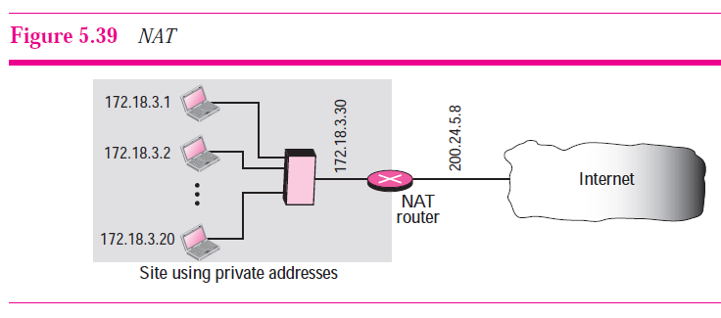
What is NAT?
Above figure shows a simple implementation of NAT.
The private network uses private addresses. The router that connects the network to the global address uses one private address and one global address.
The private network is transparent to the rest of the Internet; the rest of the Internet sees only the NAT router with the address 200.24.5.8.

Slide 81
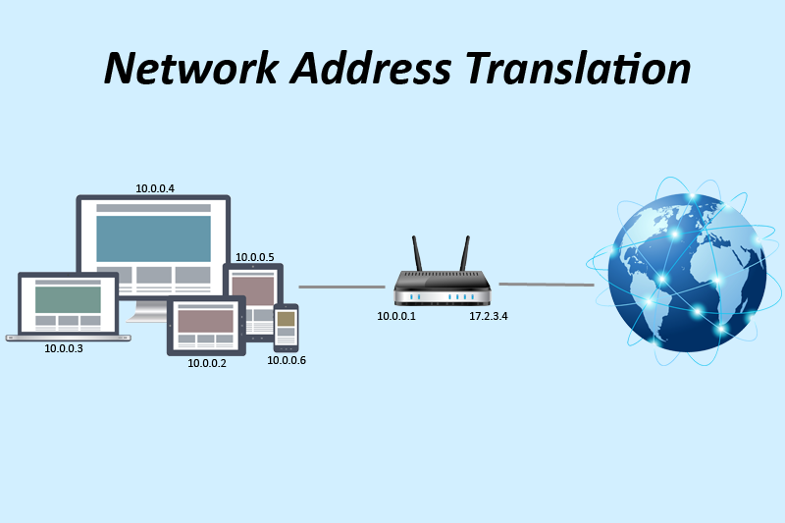
Working of NAT
Generally, the border router is configured for NAT i.e the router which has one interface in local (inside) network and one interface in the global (outside) network.
When a packet traverse outside the local (inside) network, then NAT converts that local (private) IP address to a global (public) IP address.
When a packet enters the local network, the global (public) IP address is converted to a local (private) IP address.
If NAT run out of addresses, i.e., no address is left in the pool configured then the packets will be dropped and an Internet Control Message Protocol (ICMP) host unreachable packet to the destination is sent.

Slide 82
Types of NAT
There are 3 ways to Configure NAT :
Static NAT – In this, a single unregistered (Private) IP address is mapped with a legally registered (Public) IP address i.e one-to-one mapping between local and global address.
Dynamic NAT – In this type of NAT, an unregistered IP address is translated into a registered (Public) IP address from a pool of public IP address.
Port Address Translation (PAT) – This is also known as NAT overload. In this, many local (private) IP addresses can be translated to a single registered IP address. Port numbers are used to distinguish the traffic i.e., which traffic belongs to which IP address.

Slide 83
Advantages of NAT
NAT conserves legally registered IP addresses.
It provides privacy as the device IP address, sending and receiving the traffic, will be hidden.
Eliminates address renumbering when a network evolves.

Slide 84
Disadvantages of NAT
Translation results in switching path delays.
Certain applications will not function while NAT is enabled.
Complicates tunneling protocols such as IPsec.
Also, router being a network layer device, should not tamper with port numbers(transport layer) but it has to do so because of NAT.

Slide 85
IPv6 Mobility

Slide 86
IPv6 Mobility
When a host is connected to a link or network, it acquires an IP address and all communication take place using that IP address on that link.
As soon as, the same host changes its physical location, that is, moves into another area / subnet / network / link, its IP address changes accordingly, and all the communication taking place on the host using old IP address, goes down.
IPv6 mobility provides a mechanism for the host to roam around different links without losing any communication/connection and its IP address.

Slide 87
Modules associated
Mobile Node: The device that needs IPv6 mobility.
Home Link: This link is configured with the home subnet prefix and this is where the Mobile IPv6 device gets its Home Address.
Home Address: This is the address which the Mobile Node acquires from the Home Link. This is the permanent address of the Mobile Node.
If the Mobile Node remains in the same Home Link, the communication among various entities take place as usual.
Home Agent: This is a router that acts as a registrar for Mobile Nodes. Home Agent is connected to Home Link and maintains information about all Mobile Nodes, their Home Addresses, and their present IP addresses.

Slide 88
Modules associated
Foreign Link: Any other Link that is not Mobile Node’s Home Link.
Care-of Address: When a Mobile Node gets attached to a Foreign Link, it acquires a new IP address of that Foreign Link’s subnet.
Correspondent Node: Any IPv6 enabled device that intends to have communication with Mobile Node.

Slide 89
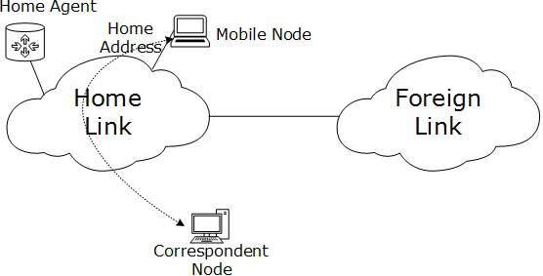
Diagrammatic Representation

Slide 90
IPv6 Mobility Operations
When a Mobile Node leaves its Home Link and is connected to some Foreign Link, the Mobility feature of IPv6 comes into play.
After getting connected to a Foreign Link, the Mobile Node acquires an IPv6 address from the Foreign Link. This address is called Care-of Address.
The Mobile Node sends a binding request to its Home Agent with the new Care-of Address.
The Home Agent binds the Mobile Node’s Home Address with the Care-of Address, establishing a Tunnel between both.
Whenever a Correspondent Node tries to establish connection with the Mobile Node (on its Home Address), the Home Agent intercepts the packet and forwards to Mobile Node’s Care-of Address over the Tunnel which was already established.

Slide 91
Route Optimization
When a Correspondent Node initiates a communication by sending packets to Mobile the Node on the Home Address, these packets are tunneled to the Mobile Node by the Home Agent.
In Route Optimization mode, when the Mobile Node receives a packet from the Correspondent Node, it does not forward replies to the Home Agent.
Rather, it sends its packet directly to the Correspondent Node using Home Address as Source Address.

Slide 92
Protocols Changed to Support IPv6

Slide 93
ICMPv6
Internet Control Message Protocol version 6 is an upgraded implementation of ICMP to accommodate IPv6 requirements.
This protocol is used for diagnostic functions, error and information message, statistical purposes.
ICMPv6’s Neighbor Discovery Protocol replaces ARP and helps discover neighbor and routers on the link.

Slide 94
DHCPv6
Dynamic Host Configuration Protocol version 6 is an implementation of DHCP.
Though IPv6 enabled hosts do not require any DHCPv6 Server to acquire IP address as they can be auto-configured.
Neither do they need DHCPv6 to locate DNS server because DNS can be discovered and configured via ICMPv6 Neighbor Discovery Protocol.
Yet DHCPv6 Server can be used to provide these information.

Slide 95
DNS
There has been no new version of DNS but it is now equipped with extensions to provide support for querying IPv6 addresses.
A new AAAA (quad-A) record has been added to reply IPv6 query messages.
Now DNS can reply with both IP versions (4 & 6) without any change in query format.

